Slide 1
Blazor: Sneak Peek
Nikolay Dermendzhiev

Slide 2

Благодарим за подкрепата!

Slide 3










https://...
JS

Slide 4
https://...

Slide 5
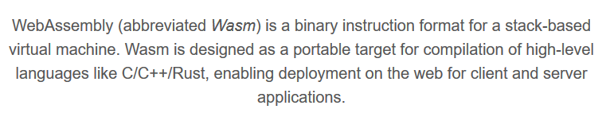
What is Blazor? (Browser + Razor)
Framework for building interactive client-side web UI with .NET
Interactive UIs using C# instead of JavaScript
Share server-side and client-side app logic written in .NET
Built on top of the open web standard WebAssembly
Works in all modern web browsers, including mobile browsers

Slide 6
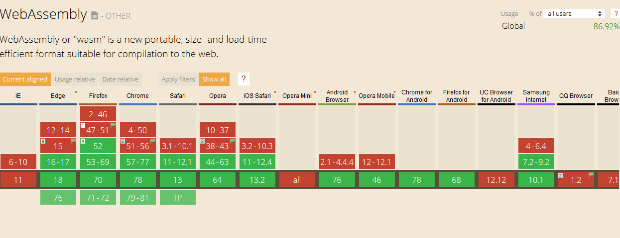
WebAssembly Support
https://caniuse.com/#feat=wasm

Slide 7
Razor Components
Blazor apps are based on components
A component is an element of UI, such as a page, dialog, or data entry form
The component class is written in the form of a Razor markup page with a .razor file extension
Razor is a syntax for combining HTML markup with C# code designed for developer productivity
Razor allows you to switch between HTML markup and C# in the same file with IntelliSense support
Razor Pages and MVC also use Razor

Slide 8
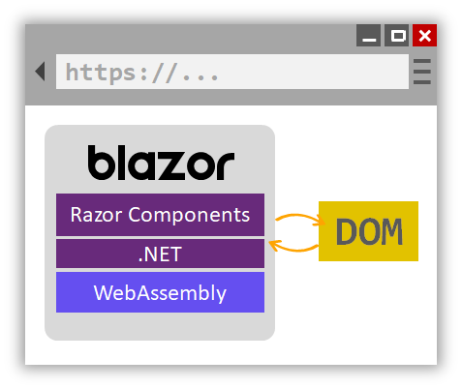

Slide 9
DEMO

Slide 10
Key points
Blazor is framework for building client-side applications with .NET
Blazor is built on top of open web standard WebAssembly
WebAssembly is byte code for the web
Blazor apps are based on Components
Inside components we have Razor which allow us to mix HTML and C#

Slide 11
Hosting models
Blazor WebAssembly (runs on the client)
Blazor Server (runs on the server)

Slide 12
Blazor on the server
Provides support for hosting Razor components on the server in an ASP.NET Core app
The runtime handles sending UI events from the browser to the server and applies UI updates sent by the server back to the browser after running the components
Integrated with ASP.NET Core SignalR

Slide 13
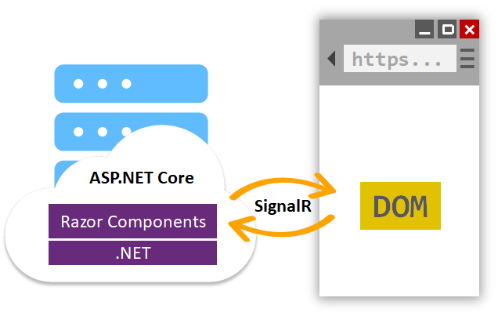
Blazor on the server

Slide 14
DEMO

Slide 15
Blazor on server or client
Blazor WebAssembly
Blazor Server
Pro
True SPA, full interactivity
Utilize client resources
Supports offline, static sites, PWA scenarios
Con
Larger download size
Requires WebAssembly
Still in preview
Pro
Smaller download size, faster load time
Running on fully featured .NET runtime
Code never leaves the server
Con
Latency
No offline support
Consumes more server resources

Slide 16
The Future of Blazor
Blazor Server
Blazor WebAssembly
Blazor PWA – OS installed (mono.wasm)
Blazor Hybrid (.NET Core)
Getting started with Blazor and Electron.NET
https://github.com/aspnet/AspLabs/tree/master/src/ComponentsElectron
Blazor Native (only experimental)
https://aka.ms/blutter

Slide 17
Roadmap
Blazor Server – Shipped with .NET Core 3.0
Blazor WebAssembly – May 2020
Blazor PWA & Electron – Previews with .NET 5
Blazor Native – Under investigation

Slide 18
More to talk about
Dependency Injection
Debugging
Routing
Intellisense and tooling
Layouts
JavaScript Interop
Forms & Validation
Unit testing

Slide 19
Try Blazor today!
Blazor: https://blazor.net
Docs: https://blazor.net/docs
.NET Core 3.0: https://dot.net/get-core3
Visual Studio: https://visualstudio.com/
Workshop: https://aka.ms/blazorworkshop
Community: https://aka.ms/awesomeblazor

Slide 20
Q&A
https://bit.ly/sofia-dotnetconf-blazor

